Slide 1
ACTIVITY BASED LEARNING
Name:Tejaswi.Arja
Section:CSE1
Roll no:26000008
Year:2026-2030

Slide 2
CASE STUDY 2
Design a college website displaying institutional information, departments, courses, faculty profiles, admissions procedures, campus facilities, events, and contact details. Create a navigation bar, banner, and responsive information cards.
EXPLANATION:
The College Information and Admissions Website is a simple website designed to provide basic information about DR. RVR NRI University. It includes a navigation bar, welcome banner, departments, faculty, admissions, campus facilities, and contact details. HTML is used to structure the webpage, and CSS is used to improve its appearance with colors, spacing, and responsive cards.

Slide 3
HTML tags used
Tag | Purpose
<!DOCTYPE html> | Defines the document as HTML5.
<html> | Root element of the webpage.
<head> | Contains page information and CSS.
<title> | Sets the browser tab title.
<style> | Adds CSS styling to the webpage.
<body> | Contains all visible webpage content.
<header> | Displays the college name and slogan.
<nav> | Creates the navigation bar.
<a> | Creates links to different sections.
<div> | Groups related content into sections and cards.
<h1>, <h2>, <h3> | Display headings in different sizes.
<p> | Displays paragraphs and information.
<footer> | Displays contact details and copyright information.

Slide 4
CSS tags used
background – Sets the background color.
color – Changes the text color.
font-family – Sets the font style.
margin – Adds space outside an element.
padding – Adds space inside an element.
text-align – Aligns text.
display: flex – Arranges cards in a flexible layout.
flex-wrap: wrap – Moves cards to the next line when needed.
gap – Adds space between cards.
border-radius – Rounds the corners of cards.
SCREENSHOTS

Slide 5
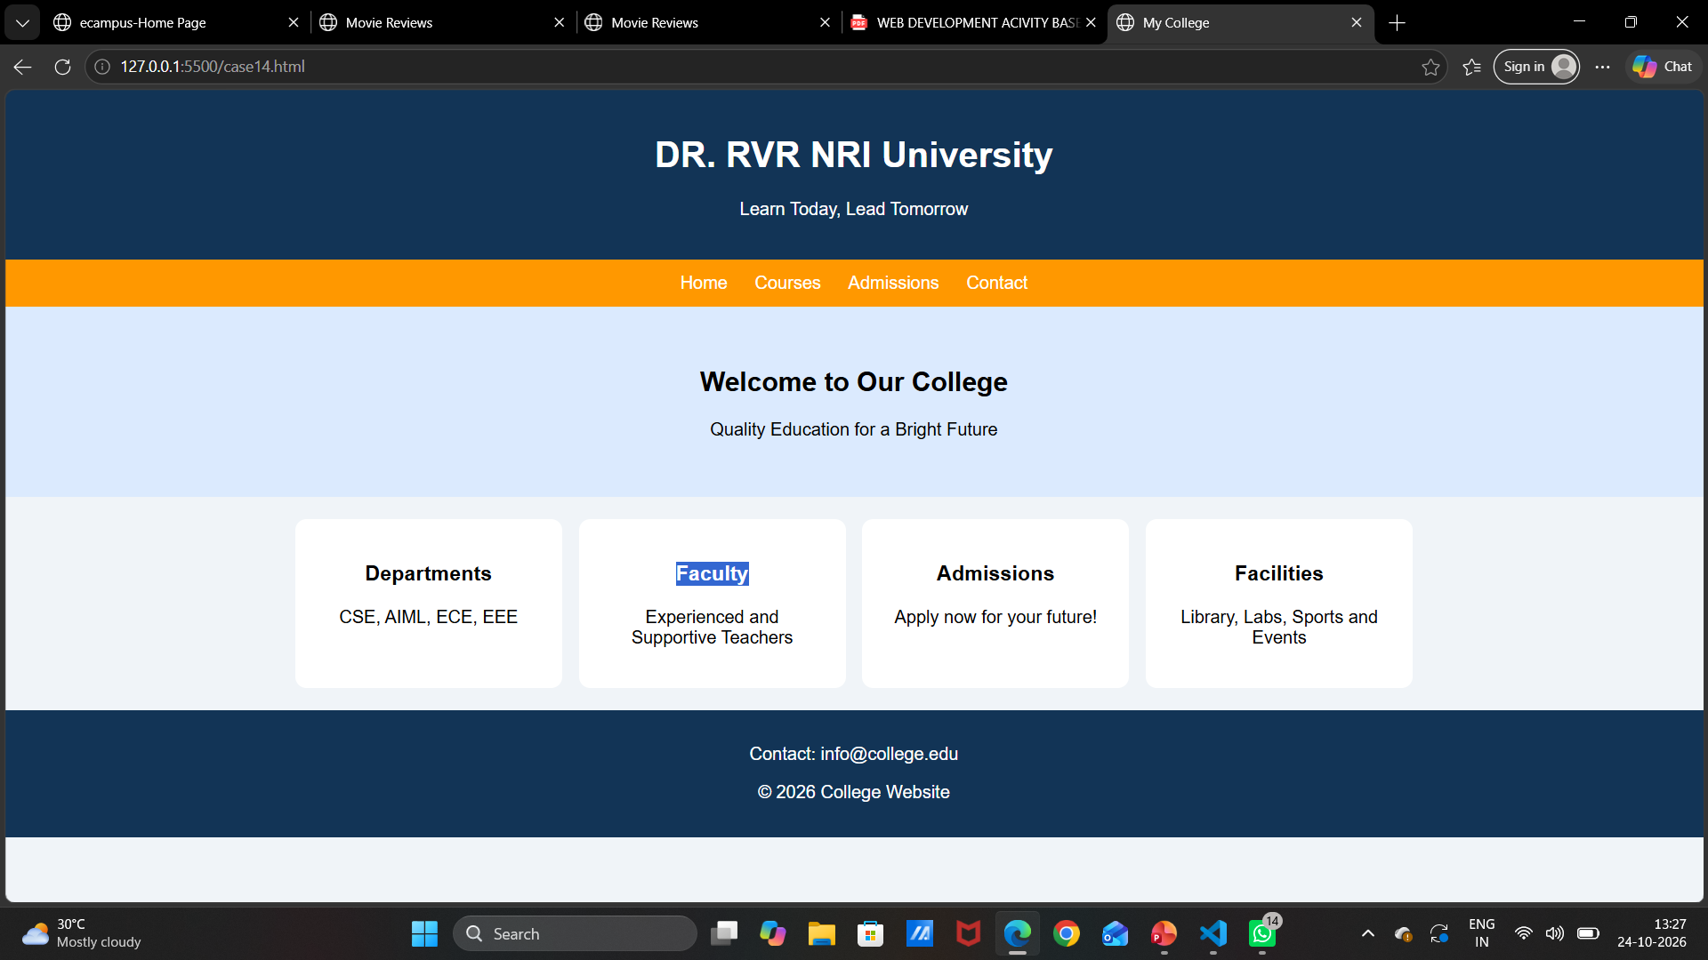
SCREENSHOTS:

Slide 6
CASE 14
Build a website displaying nutritious recipes, meal plans, ingredient lists, calorie information, healthy eating tips, and food categories. Present information through responsive cards and recipe layouts.
EXPLANATION:
The Healthy Food and Nutrition Website is a simple webpage that provides information about healthy recipes, their ingredients, and calorie values. It displays fruit salad, vegetable salad, and oatmeal in attractive cards. It also includes healthy eating tips to encourage people to follow a balanced diet. HTML is used to create the webpage structure, and CSS is used to add colors, spacing, and styling.

Slide 7
HTML Tags Used:
Tag | Purpose
<!DOCTYPE html> | Declares the document as HTML5.
<html> | Defines the HTML document.
<head> | Contains webpage information.
<title> | Sets the browser tab title.
<style> | Adds CSS styling.
<body> | Contains the visible webpage content.
<header> | Displays the website title and slogan.
<h1> | Displays the main heading.
<h2> | Displays section headings.
<h3> | Displays recipe names.
<p> | Displays ingredients, calories, and tips.
<div> | Groups recipe cards and their content.
<footer> | Displays the closing message and copyright.

Slide 8
CSS Tags Used:
•font-family – Sets the font style.
•background – Sets the background color.
•color – Changes the text color.
•text-align – Aligns text to the center.
•margin – Adds space outside elements.
•padding – Adds space inside elements.
•display: flex – Arranges recipe cards in a flexible layout.
•flex-wrap: wrap – Moves cards to the next line when necessary.
•gap – Adds space between cards.
•border-radius – Rounds the corners of the cards.

Slide 9
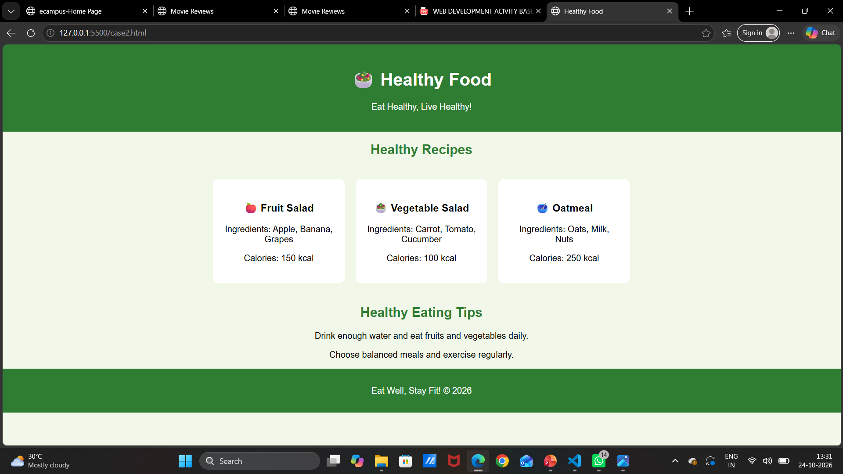
SCREENSHOTS:

Slide 10
CASE STUDY 22
Create a movie website featuring film posters, genres, release dates, cast information, synopsis, critic reviews, and rating displays. Use responsive grids and visually appealing movie cards.
EXPLAINATION:
The Movie Review Website is a simple webpage that displays movie posters, movie names, ratings, genres, release years, and short descriptions. It features three movies: Inception, Interstellar, and Oppenheimer. HTML is used to create the webpage structure, while CSS adds colors, spacing, and attractive movie cards. The Flexbox layout helps arrange the cards neatly and allows them to wrap onto new lines when needed.

Slide 11
HTML Tags Used:
<!DOCTYPE html> | Declares the document as HTML5.
<html> | Defines the HTML document.
<head> | Contains webpage information and styles.
<title> | Sets the browser tab title.
<style> | Contains CSS code.
<body> | Contains all visible webpage content.
<h1> | Displays the main heading.
<h3> | Displays movie names and subheadings.
<div> | Groups movie cards and related content.
<img> | Displays movie posters using image URLs.
<p> | Displays ratings, genres, years, and descriptions.

Slide 12
CSS Tags Used:
background | Sets the background color.
color | Changes the text color.
font-family | Sets the font style.
text-align | Aligns text to the center.
display: flex | Arranges movie cards in a flexible layout.
justify-content: center | Centers the movie cards horizontally.
flex-wrap: wrap | Moves cards to the next line when needed.
gap | Adds space between movie cards.
padding | Adds space inside an element.
width | Sets the width of an element.
height | Sets the height of an element.
object-fit: cover | Fits images into the specified area while maintaining their proportions as much as possible.
border-radius | Rounds the corners of movie cards.

Slide 13
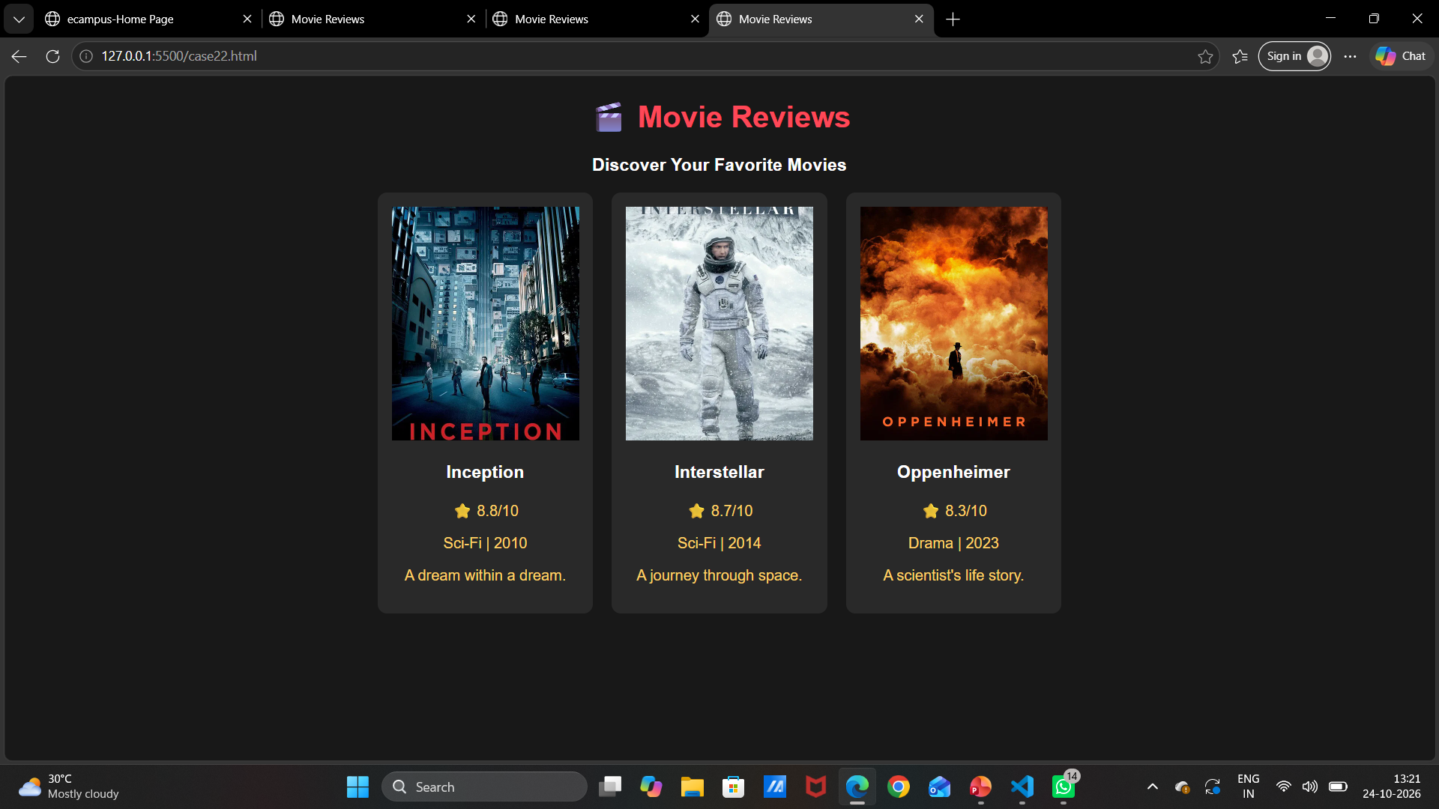
SCREENSHOTS:

